Slide 1
welcome

Slide 2
TABLE OF CONTENT
About our team
About e-commerce
Our system and process
About shoe store Webpage
Web technologies and software
Modelling
home page of webpage
Types of shoes
About the products
Link for the webpage

Slide 3
TEAM MEMBERS
ADDIPALLI PRIYANKA(TEAM LEAD)
BOLISETTY VENKATA KUSUMA
BEHERA RAMYA
BODALA KEERTHI

Slide 4

PRESENTATION ON E-COMMERCE(ONLINE SHOPPING)

Slide 5
INTRODUCTION
What is Electronic Commerce?
The simplest ecommerce definition is “commercial transactions conducted over the internet” or internet commerce. Basically, it’s nothing more than buying something online, or online shopping. If you’re one of the millions of people who shop on Amazon, you’re already familiar with ecommerce from the consumer’s point of view.

Slide 6
OUR SYSTEM
Our system is an e-commerce website where users can buy the products in online
Admin monitors the activity of the users and check the transactions

Slide 7
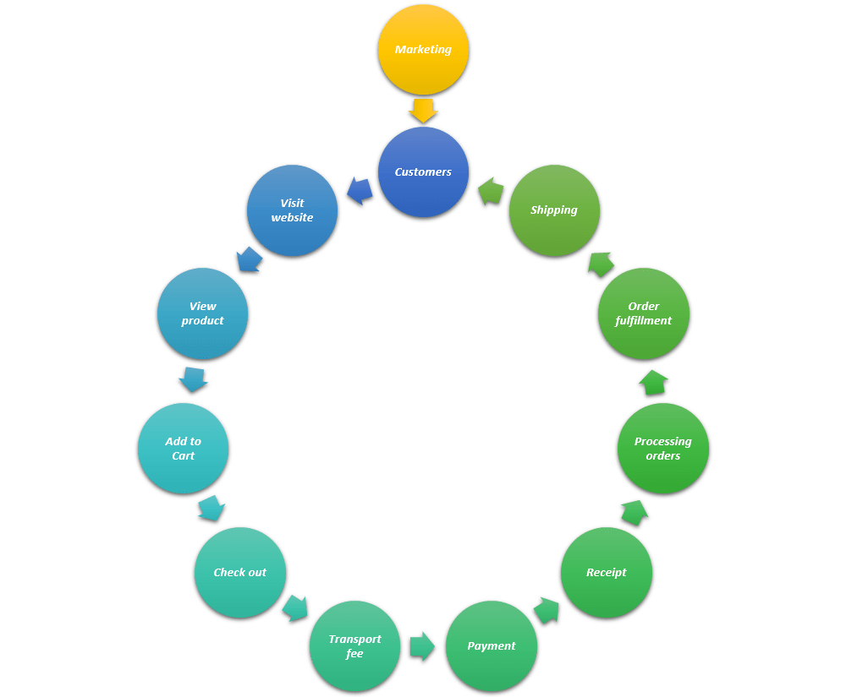
THE PROCESS OF E-COMMERCE

Slide 8
SHOE STORE WEBPAGE
Designed an online Shoe store webpage using web technologies and certain Software.

Slide 9
WEB TECHNOLOGIES
SOFTWARE
Hypertext Mark up language(HTML)
Cascading style sheets(CSS)
java script(JS)
VISUAL STUDIO

Slide 10
MODELLING
HTML: It stands for hypertext Markup language which describes the structure of webpage.
CSS: It stands for cascading , style sheets which describes how html elements are displayed on screen . It controls multiple webpages at once.
JAVASCRIPT: It is cross-platform , object-oriented scripting language which makes the webpage interactive.

Slide 11
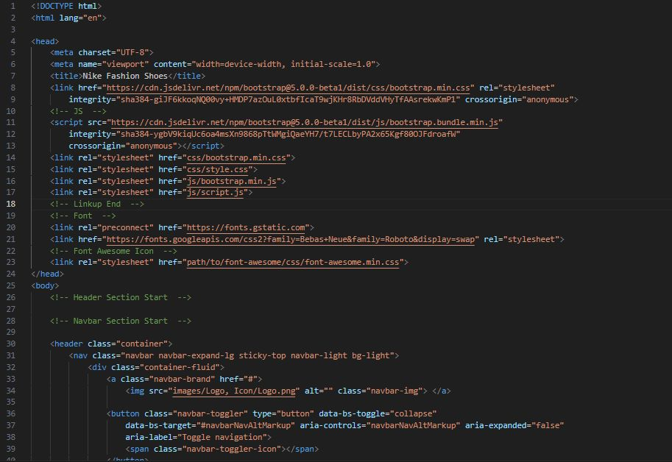
HTML
HTML stands for HyperText Markup Language.
It's the standard markup language used to
create and structure content on the web.
HTML uses a system of tags to define the
elements of a webpage, such as headings,
paragraphs, images, links, and more.
These tags provide the structure and
layout for displaying content in web browsers

Slide 12
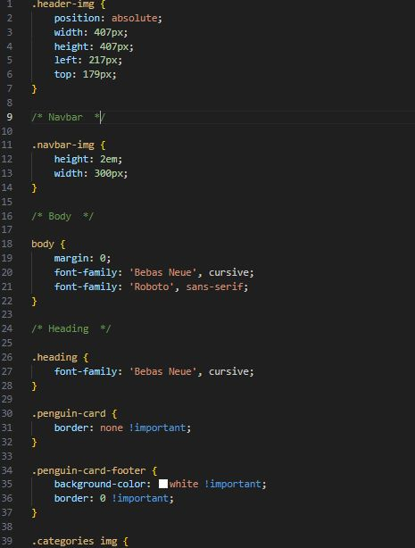
CSS
Cascaded style sheet is used to control the presentation and layout of a web page. It defines how the HTML elements should be styled, such as their colours, fonts, spacing, positioning, and responsiveness. CSS allows you to separate the visual design of a webpage from its structural content, making it easier to maintain and update the appearance of a site

Slide 13
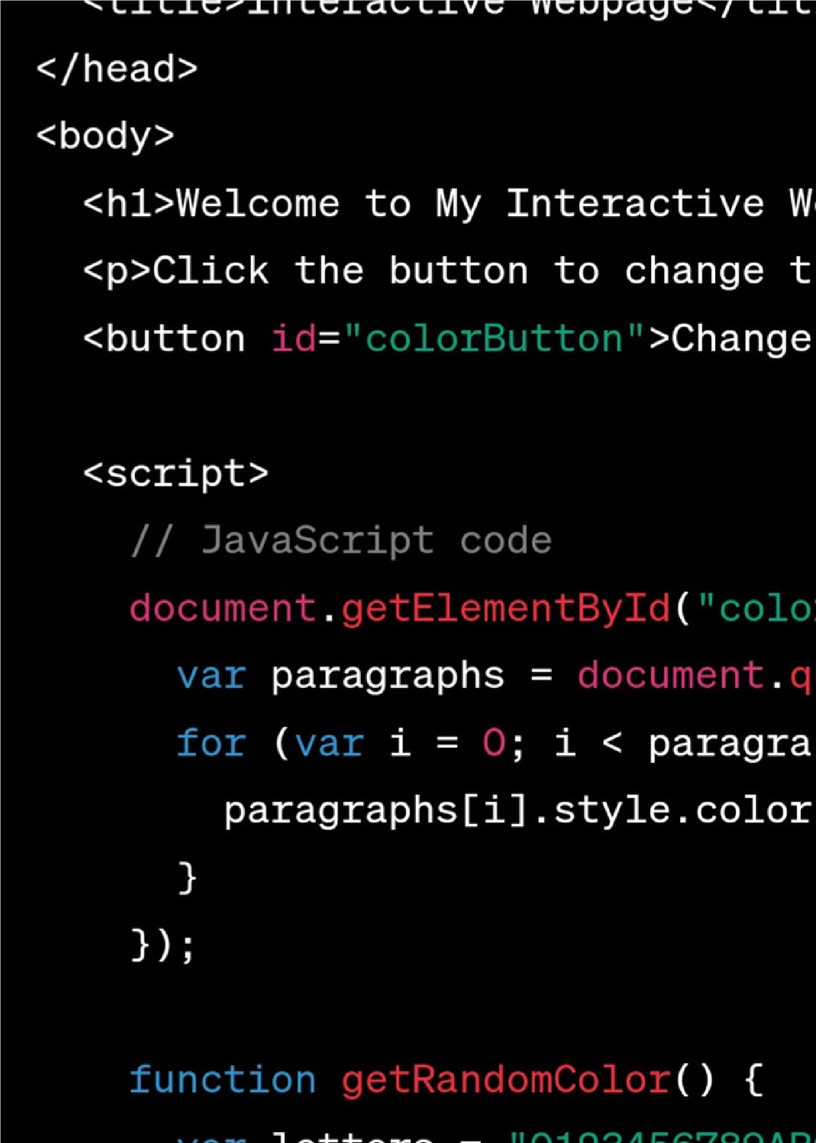
JAVASCRIPT
JavaScript is a versatile and widely used
programming language primarily
employed for adding interactivity,
behaviour , and Dynamic features to web
pages. It allows developers to create
interactive elements that respond to user
actions without requiring a page refresh

Slide 14
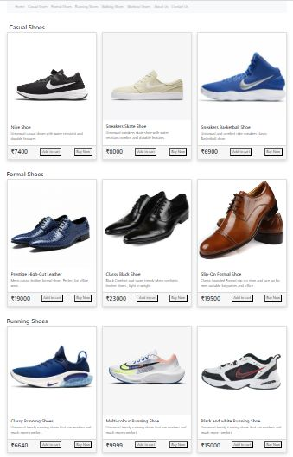
OUR WEBPAGE
HOME PAGE

Slide 15
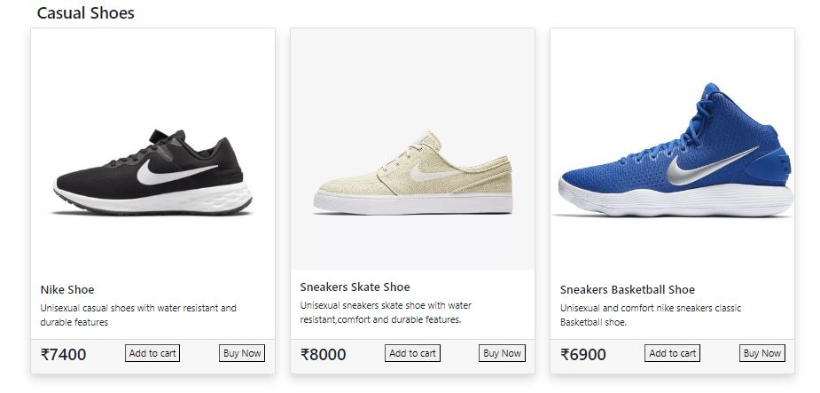
CASUAL SHOES

Slide 16
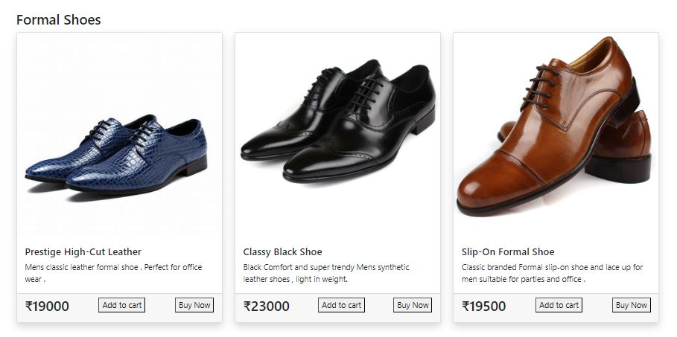
FORMAL SHOES

Slide 17
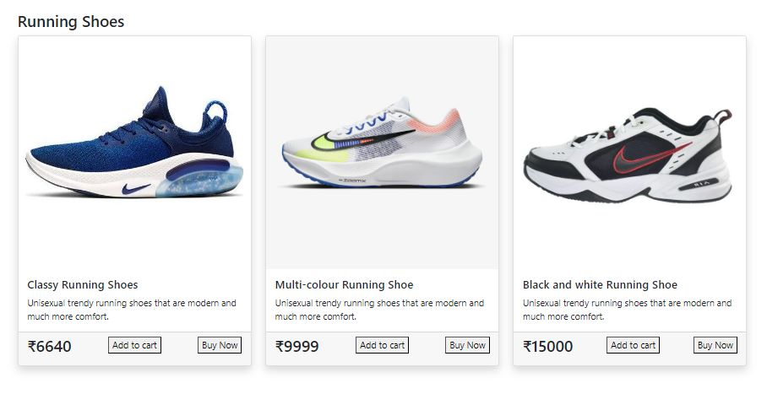
RUNNING SHOES

Slide 18
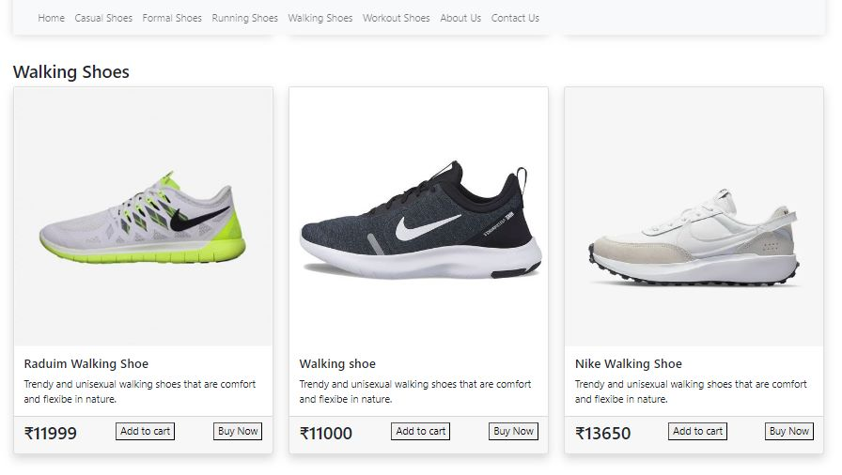
WALKING SHOES

Slide 19
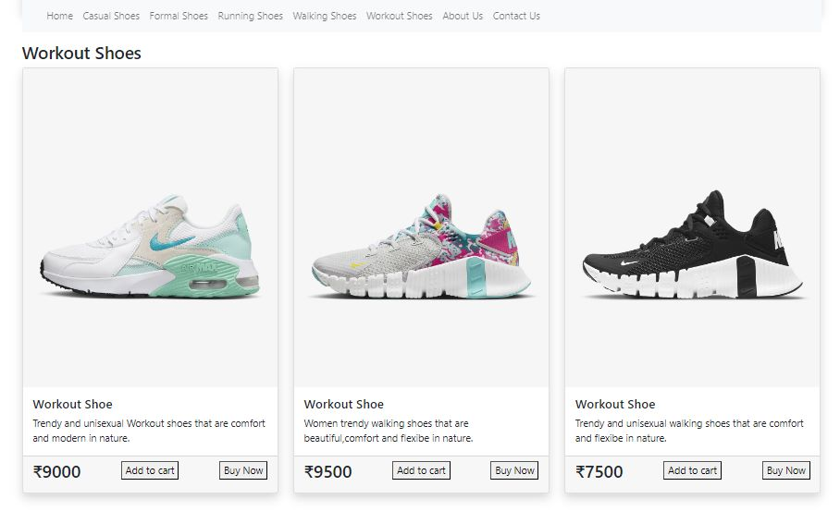
WORKOUT SHOES

Slide 20
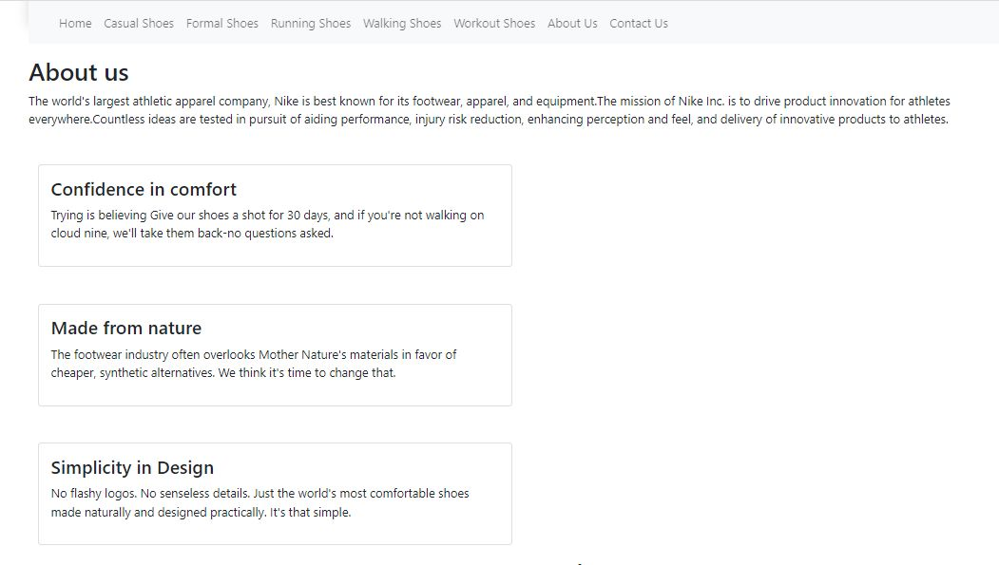

Slide 21
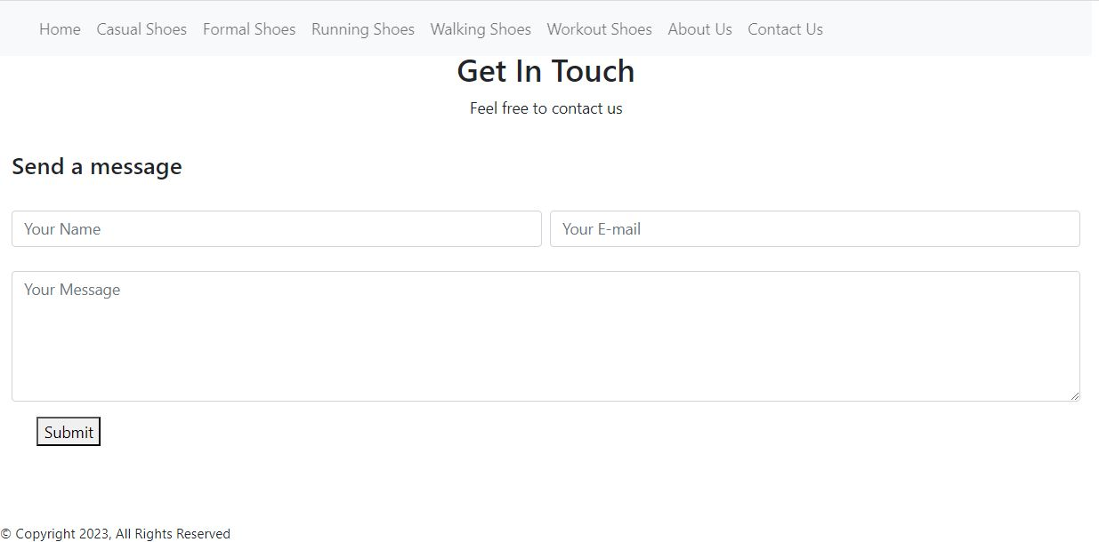
GITHUB LINK TO ACCESS THE BREIF INFORMATION ABOUT OUR WEBPAGE :
https://github.com/priyankaaddipalli/Ecommerce-Shoe-Store

Slide 22
THANK YOU

